Slide 1
School subjects
Basic 02 – Unit 4B

Slide 2
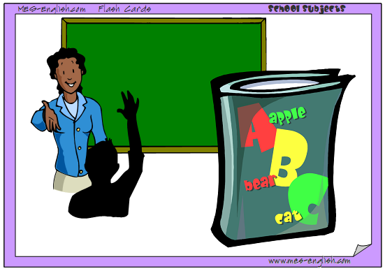
English

Slide 3
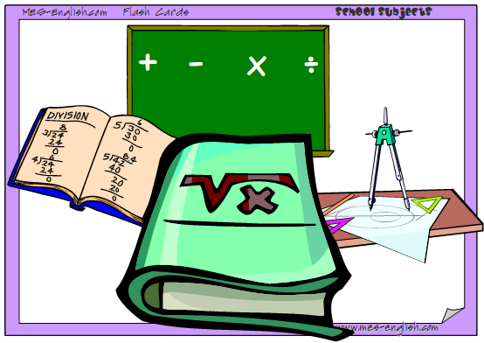
Math

Slide 4
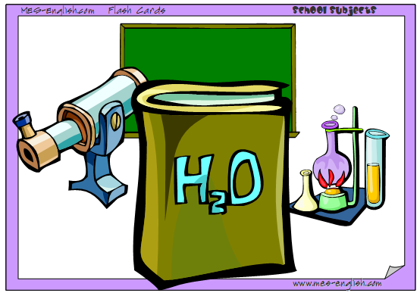
chemistry

Slide 5

Geography

Slide 6
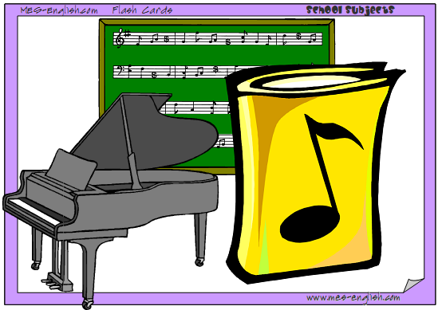
Music

Slide 7
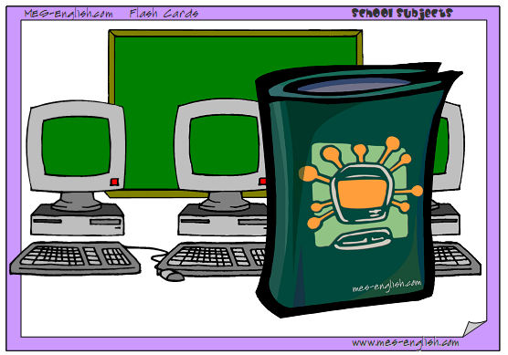
Computer class

Slide 8
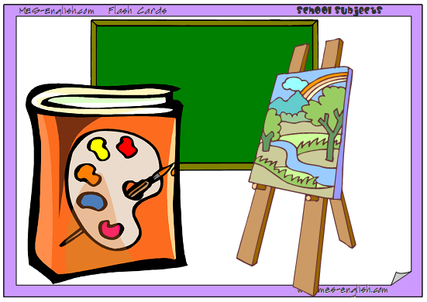
Art

Slide 9
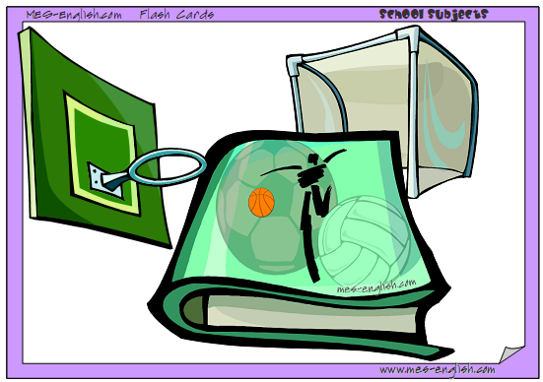
Physical education

Slide 10
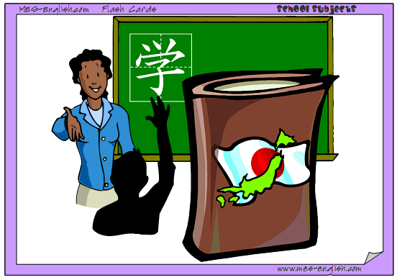
Japanese

Slide 11

Social studies

Slide 12

Science

Slide 13
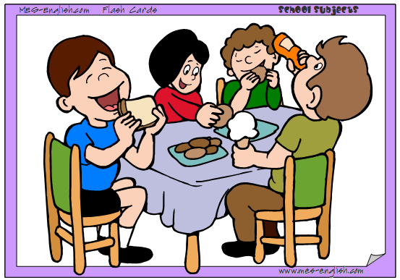
Lunch

Slide 14
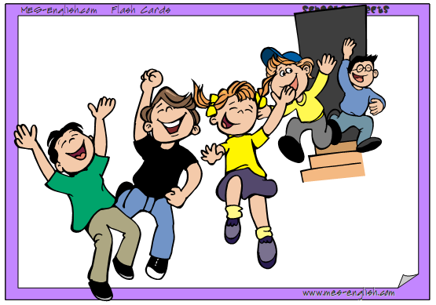
Recess / break

Slide 15


1. Are the majors below popular Peru?
+Yes, they are. Engineering is very popular.
-No, they aren´t. ______ is popular in Peru.
2. What is your major or favorite subject?
I´m majoring in ________. / I´m a ________ major.
My favorite subject is ___/ My favorite subjects are ____.
3. What classes are you taking now? Which class is your favorite?
Which would you you take?
+Now, I am taking _________________. My favorite class is _________. And I would like to take ____________.
-Right now, I´m not taking any clases.

Slide 17
Days of the Week
Basic 02

Slide 25
Student Life

Slide 26
